Slide 1


IBM Data Science Capstone Project
Space X Falcon 9 Landing Prediction
Jeffrey Hsieh

Slide 2
Outline
Executive Summary
Introduction
Methodology
Results
Conclusion
Appendix

Slide 3
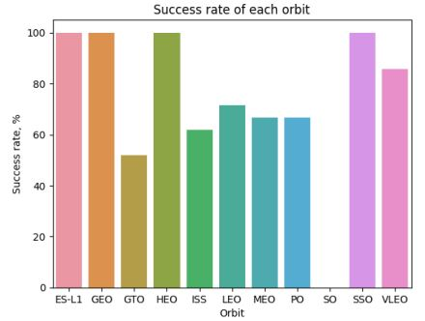
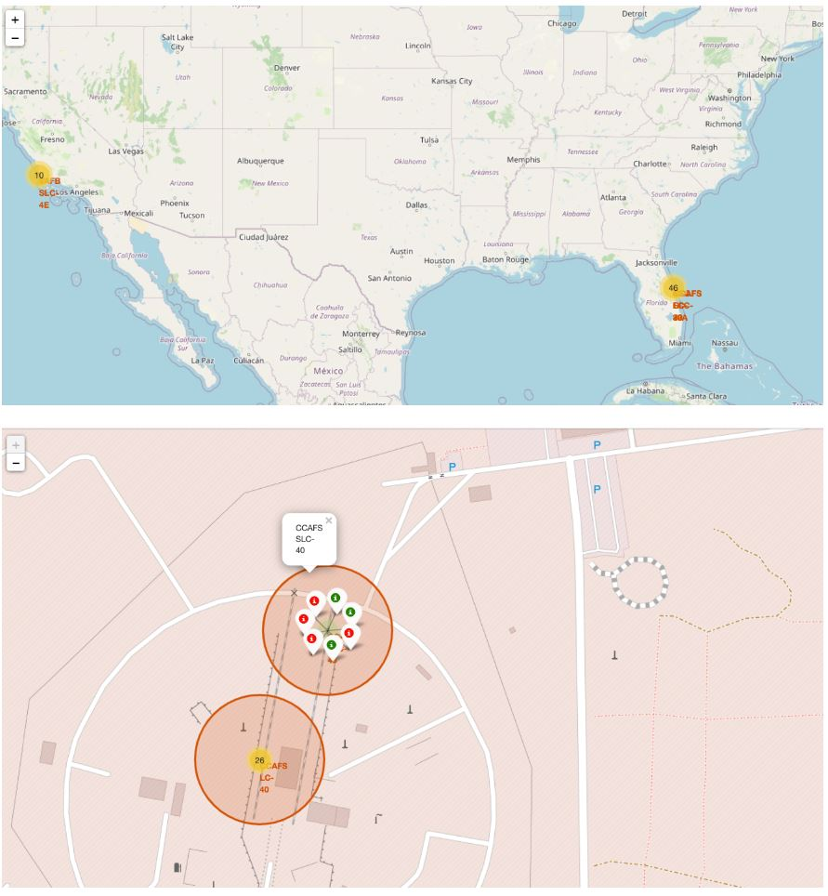
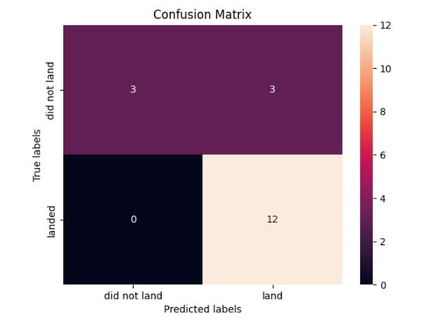
Executive Summary
Summary of Methodologies:
Data Collection
Data Wrangling
Exploratory Data Analysis
Interactive Visual Analytics
Predictive Analysis (Classification)
Summary of Results:
Exploratory Data Analysis (EDA) results
Geospatial analytics
Interactive dashboard
Predictive analysis of classification models

Slide 4
Introduction
Project background:
SpaceX advertises Falcon 9 rocket launches on its website with a cost of 62 million dollars; other providers cost upward of 165 million dollars each, much of the savings is because SpaceX can reuse the first stage.
Problems Statement:
Predict if the first stage will land successfully as well as the cost of a launch in order to bid against SpaceX for a rocket launch.

Slide 5
Methodology
Data Collection:
SpaceX API
Web Scrapping from Wikipedia
Data Wrangling:
Data cleaning, e.g., replacing null value with mean or median
One Hot Encoding
Exploratory Data Analysis (EDA) using Visualization and SQL
Interactive Visual Analytics using Folium and Plotly Dash
Predictive Analysis using Classification Models
Model comparison : Linear Regression, Decision Tress, K-Nearest Neighbors (KNN),
Logistic Regression, Support Vector Machine (SVM)
Model evaluation : R2, RMSE, Accuracy Score, F1-Score, Jaccard Index, Log-Loss-Loss

Slide 6
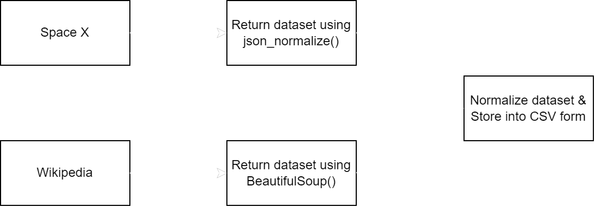
Data Collection
The data sets were collected through below two methods:
SpaceX API
Web Scrapping from Wikipedia
Data collection process:

Slide 7
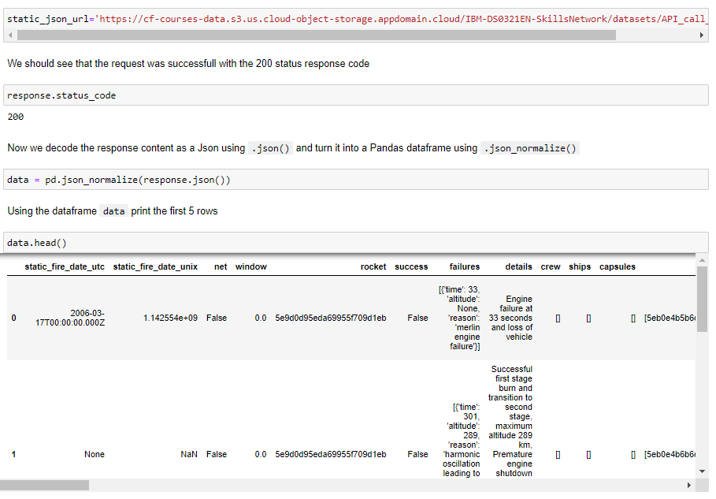
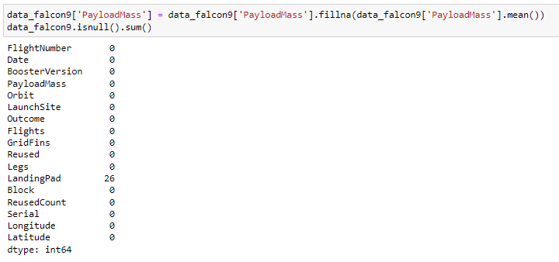
Data Collection – SpaceX API
Data collection with SpaceX REST calls
Request rocket launch data from SpaceX API
Request and parse SpaceX launch data with a GET request and turning the JSON into a Pandas dataframe
Use the functions created for using the API to extract information
Construct dataset from data obtained from API and GET functions into a pandas dictionary with updating columns and rows.
Replace null values with mean and export to CSV file.
Click here for more detail and code.

Slide 8
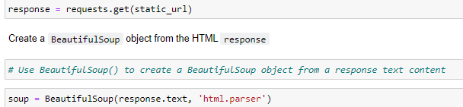
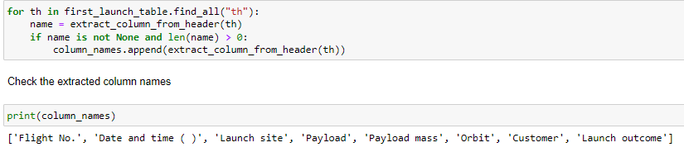
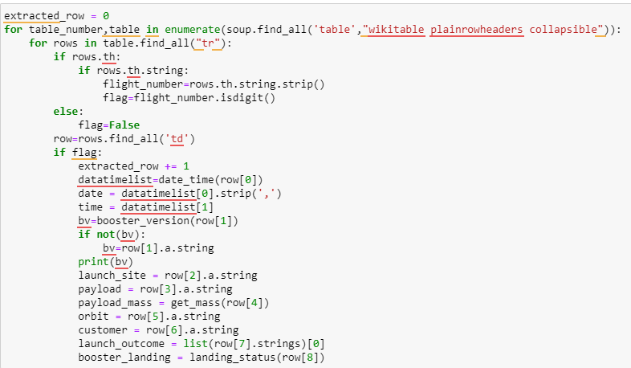
Data Collection – Web Scraping
Data collection with web scraping process
Request Falcon9 Launch HTML page HTTP method
Create BeautifulSoup object
Extract column name by iterate through each <th> element from HTML table header.
Fill launch dictionary with launch records extracted from table rows with for loop to append into.
Create dataframe from launch_dict with parsed launch values now added and export to CSV file.
Click here for more detail and code.

Slide 9
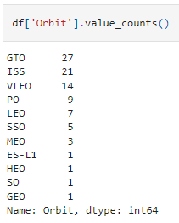
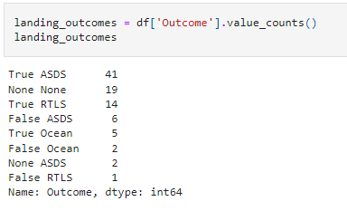
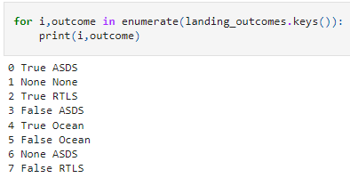
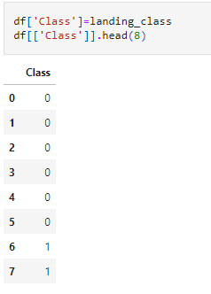
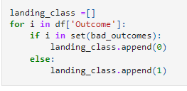
Data Wrangling
Load dataset from last section with read_csv function
Calculate the number of column on each site with value_counts saperately.
Use for loop to assign numbers to landing_outcomes, and list the failed landing outcomes
Present list of outcomes with Class assigned as '0' or '1' for failure or success, respectively and export to CSV file.
Click here for more detail and code.

Slide 10
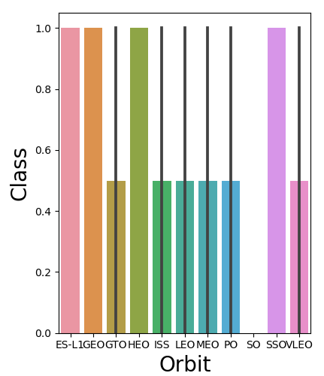
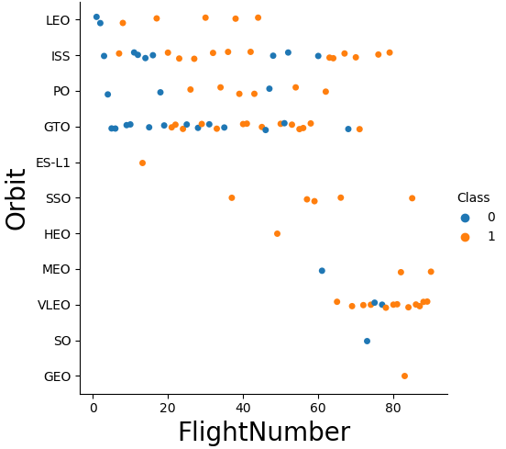
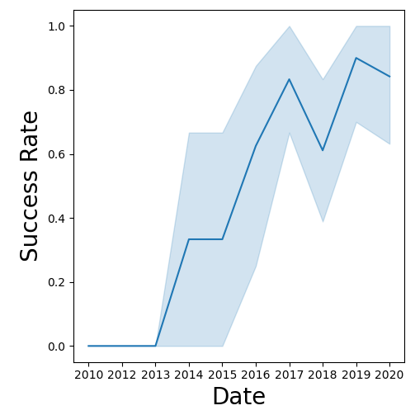
EDA with Data Visualization
Visualize the relationship between success rate of each orbit type
Visualize the relationship between FlightNumber and Orbit type
Visualize the launch success yearly trend
Create dummy variables to categorical columns
Click here for more detail and code.

Slide 11
EDA with SQL
The SQL queries performed on the data set were used to:
1. Display the names of the unique launch sites in the space mission
2. Display 5 records where launch sites begin with the string ‘CCA’
3. Display the total payload mass carried by boosters launched by NASA (CRS)
4. Display the average payload mass carried by booster version F9 v1.1
5. List the date when the first successful landing outcome on a ground pad was achieved
6. List the names of the boosters which had success on a drone ship and a payload mass between 4000 and 6000 kg
7. List the total number of successful and failed mission outcomes
8. List the names of the booster versions which have carried the maximum payload mass
9. List the failed landing outcomes on drone ships, their booster versions, and launch site names for 2015
10. Rank the count of landing outcomes (such as Failure (drone ship) or Success (ground pad)) between the date 2010-06-04 and 2017-03-20, in descending order
Click here for more detail and code.

Slide 12
Build an Interactive Map with Folium
Mark all launch sites on a map
Initialise the map using a Folium Map object
Add a folium.Circle and folium.Marker for each launch site on the launch map
Mark the success/failed launches for each site on a map
As many launches have the same coordinates, it makes sense to cluster them together.
Before clustering them, assign a marker colour of successful (class = 1) as green, and failed (class = 0) as red.
To put the launches into clusters, for each launch, add a folium.Marker to the MarkerCluster() object.
Create an icon as a text label, assigning the icon_color as the marker_colour determined previously.
Calculate the distances between a launch site to its proximities
To explore the proximities of launch sites, calculations of distances between points can be made using the Lat and Long values.
After marking a point using the Lat and Long values, create a folium.Marker object to show the distance.
To display the distance line between two points, draw a folium.PolyLine and add this to the map.
Click here for more detail and code.

Slide 13
Build a Dashboard with Plotly Dash
Pie chart (px.pie()) showing the total successful launches per site
This makes it clear to see which sites are most successful
The chart could also be filtered (using a dcc.Dropdown() object) to see the success/failure ratio for an individual site
Scatter graph (px.scatter()) to show the correlation between outcome (success or not) and payload mass (kg)
This could be filtered (using a RangeSlider() object) by ranges of payload masses
It could also be filtered by booster version
Click here for more detail and code.

Slide 14
Predictive Analysis (Classification)
Model Development
Create a GridSearchCV object and a dictionary of parameters
Fit the object to the parameters
Use the training data set to train the model
Model Evaluation
Using the output GridSearchCV object
Plot and examine the Confusion Matrix
Finding the Best Classification Model
Review the accuracy scores for all chosen algorithms and record the highest one
Click here for more detail and code.

Slide 15
Results
Exploratory data analysis results
The success rate kept increasing since year 2013.
Orbit at ES-L1, GEO, HEO & SSO with a 100% success rate for rocket launching.
Based on scatter point chart, you will find that the VAFB-SLC launch site has no rockets
launched for heavy payload mass (greater than 10000).
Interactive analytics demo in screenshots
KSC LC-39A had the most successful launches compared with the other sites.
Predictive analysis results
Decision tree is the best model in terms of prediction accuracy in this dataset

Slide 16
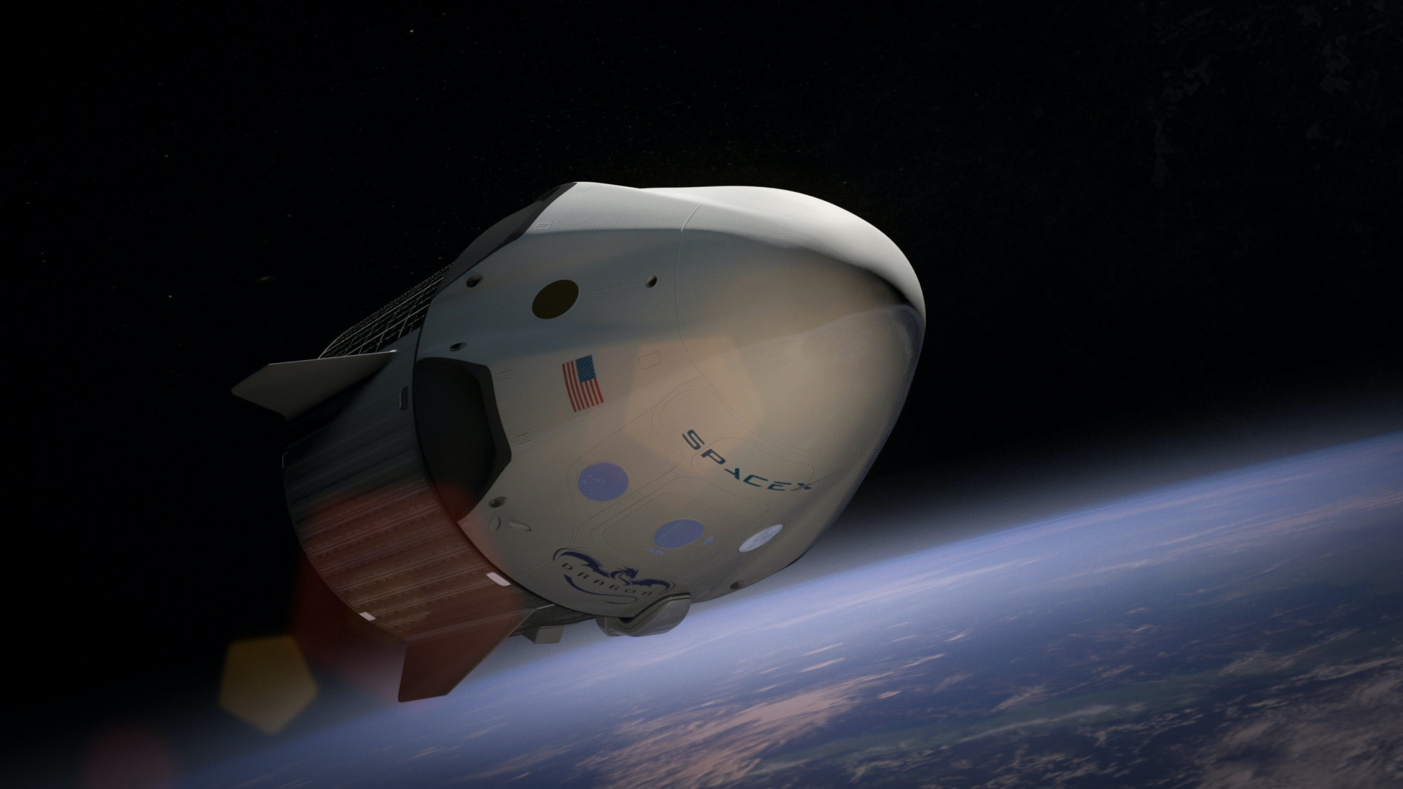
Data Visualization

Slide 17
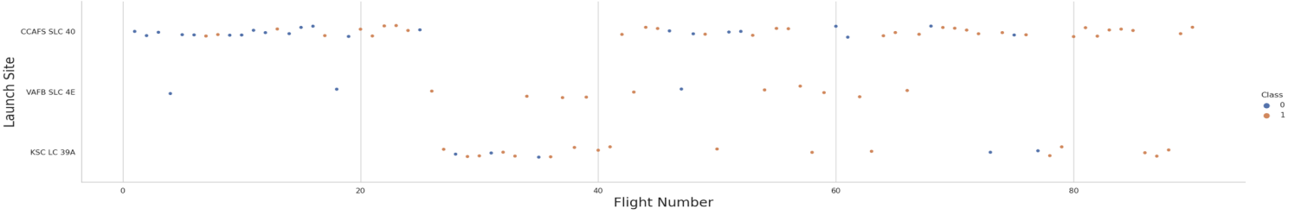
Flight Number vs. Launch Site
Flight Number increases, the first stage is more likely to land successfully with
more results of Class "1" for Successful Outcome. This indicates a relationship.

Slide 18
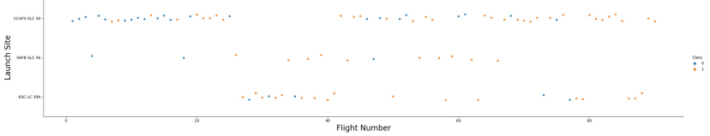
Payload vs. Launch Site
Rocket launching from the launch site of CCAFS SLC 40 are significantly higher than the rest of other sites.

Slide 19
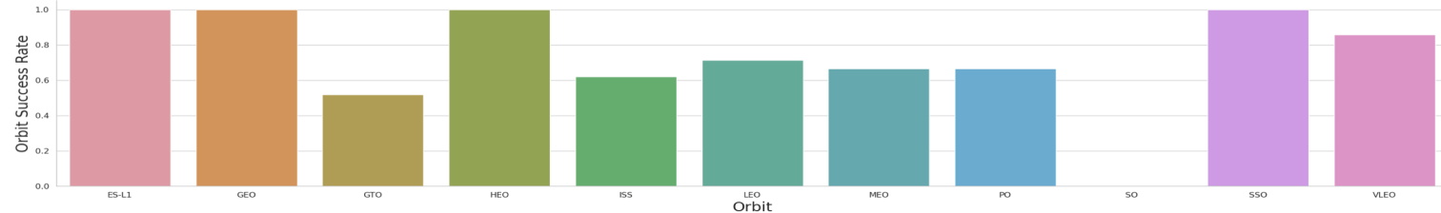
Success Rate vs. Orbit Type
Based on scatter point chart, you will find that the VAFB-SLC launch site has no rockets
launched for heavy payload mass (greater than 10000).

Slide 20
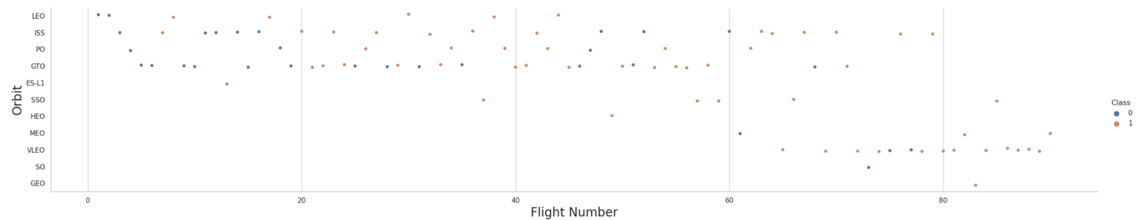
Flight Number vs. Orbit Type
The scatterplot can show some cases where the Orbit Type can be considered related to the Flight Number, and other cases where there is no definitive relationship to infer.

Slide 21
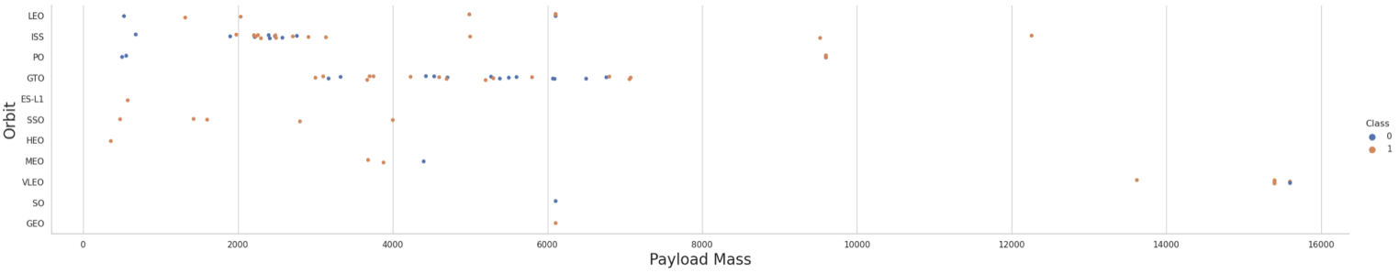
Payload vs. Orbit Type
The more likely they are successful landings. This can mean a relationship is present between mass and the orbit type with the success of the landing.

Slide 22
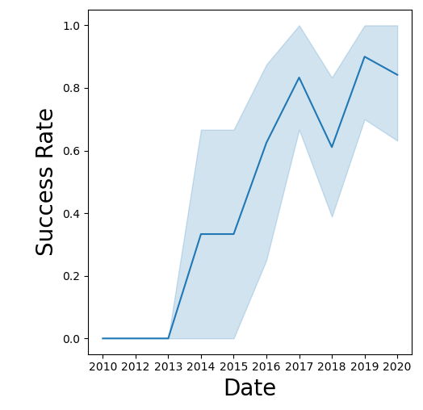
Launch Success Yearly Trend
Between 2010 and 2013, all landings were unsuccessful (as the success rate is 0).
After 2013, the success rate generally increased, despite small dips in 2018 and 2020.
After 2016, there was always a greater than 50% chance of success.

Slide 23
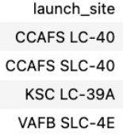
All Launch Site Names
%sql SELECT DISTINCT LAUNCH_SITE FROM SPACEX ORDER BY 1

Slide 24
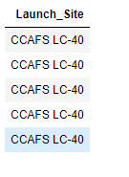
Launch Site Names Begin with 'CCA'
%sql SELECT DISTINCT LAUNCH_SITE FROM SPACEX ORDER BY 1

Slide 25
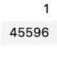
Total Payload Mass
• %sql SELECT SUM(PAYLOAD_MASS__KG_) FROM SPACEX WHERE CUSTOMER = 'NASA (CRS)'

Slide 26
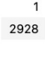
Average Payload Mass by F9 v1.1
%sql SELECT AVG(PAYLOAD_MASS__KG_) FROM SPACEX WHERE BOOSTER_VERSION = 'F9 v1.1'

Slide 27
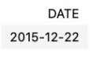
First Successful Ground Landing Date
%sql SELECT DATE FROM SPACEX WHERE LANDING__OUTCOME = 'Success (ground pad)' LIMIT 1

Slide 28
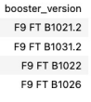
Successful Drone Ship Landing with
Payload between 4000 and 6000
%%sql
SELECT DISTINCT BOOSTER_VERSION
FROM SPACEX
WHERE LANDING__OUTCOME = 'Success (drone ship)’
AND PAYLOAD_MASS__KG_ BETWEEN 4000 AND 6000 ORDER BY 1

Slide 29
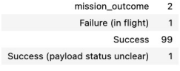
Total Number of Successful and Failure
Mission Outcomes
%%sql
SELECT MISSION_OUTCOME, COUNT(*) AS REC
FROM SPACEX
GROUP BY MISSION_OUTCOME
ORDER BY MISSION_OUTCOME

Slide 30
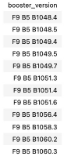
Boosters Carried Maximum Payload
%%sql
SELECT DISTINCT BOOSTER_VERSION
FROM SPACEX
WHERE PAYLOAD_MASS__KG_ =
(SELECT MAX(PAYLOAD_MASS__KG_)
FROM SPACEX)
ORDER BY 1

Slide 31
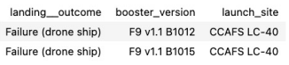
2015 Launch Records
%%sql
SELECT
LANDING__OUTCOME, BOOSTER_VERSION, LAUNCH_SITE
FROM SPACEX
WHERE LANDING__OUTCOME = 'Failure (drone ship)’
AND EXTRACT(YEAR FROM DATE) = 2015
GROUP BY LANDING__OUTCOME, BOOSTER_VERSION, LAUNCH_SITE
ORDER BY LANDING__OUTCOME, BOOSTER_VERSION, LAUNCH_SITE

Slide 32
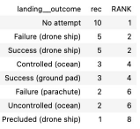
Rank Landing Outcomes Between 2010-06-04 and 2017-03-20
%%sql
SELECT *, RANK() OVER (ORDER BY REC DESC) AS RANK
FROM ( SELECT LANDING__OUTCOME, COUNT(*) AS REC
FROM SPACEX
WHERE DATE BETWEEN '2010-06-04' AND '2017-03-20’
GROUP BY LANDING__OUTCOME
)

Slide 33
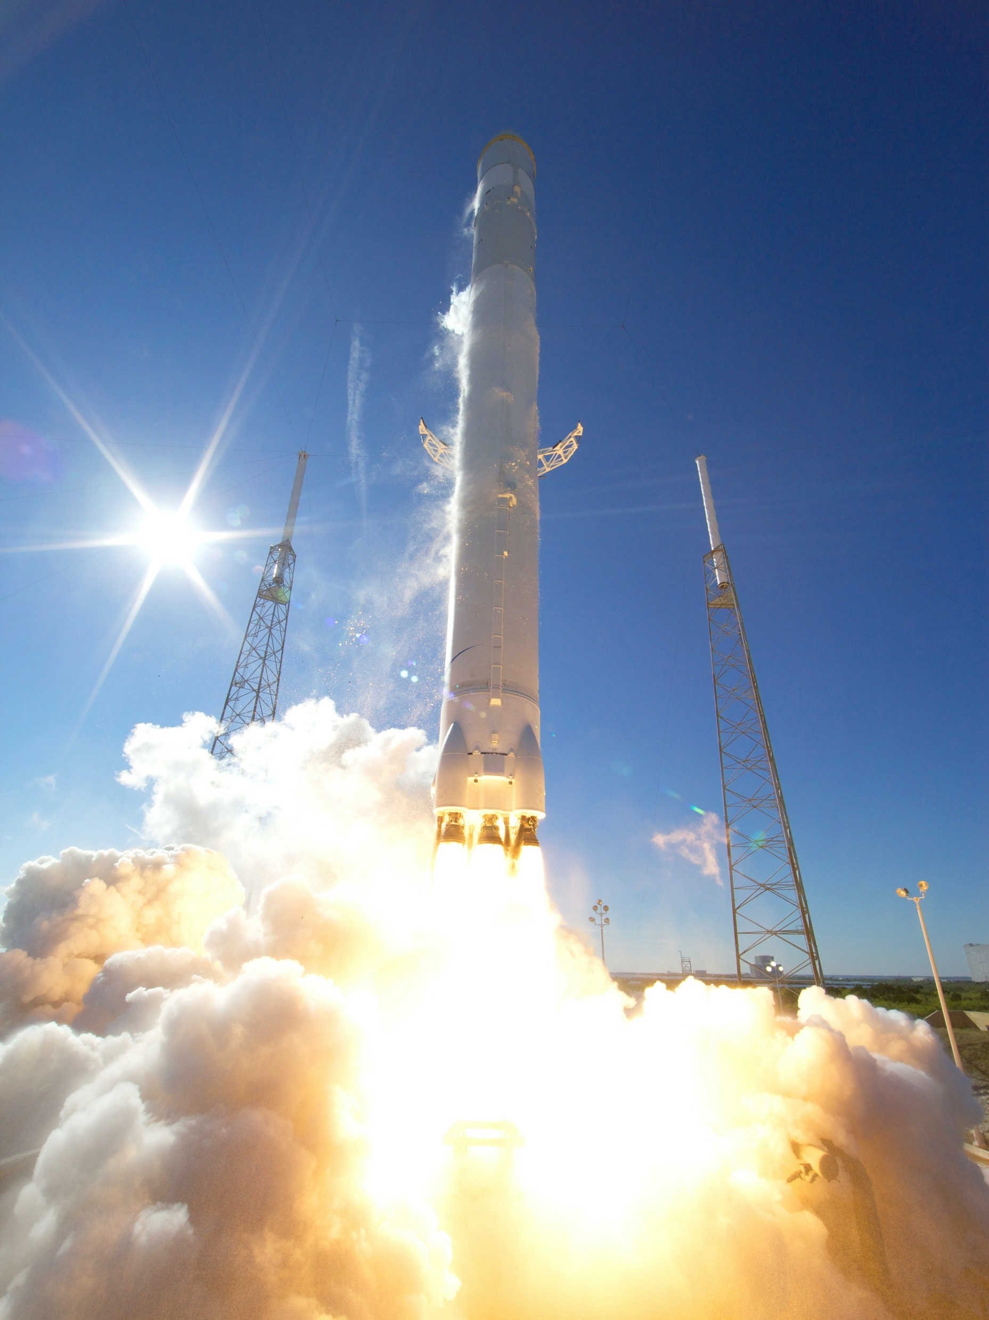
LAUNCH SITES
PROXIMITY ANALYSIS

Slide 34

<Folium Map Screenshot 1>

Slide 35

<Folium Map Screenshot 2>

Slide 36

<Folium Map Screenshot 3>

Slide 37

Build a Dashboard
With Plotly Dash

Slide 38
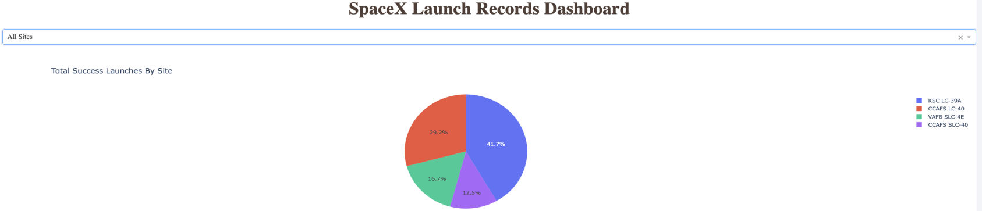
<Dashboard Screenshot 1>

Slide 39
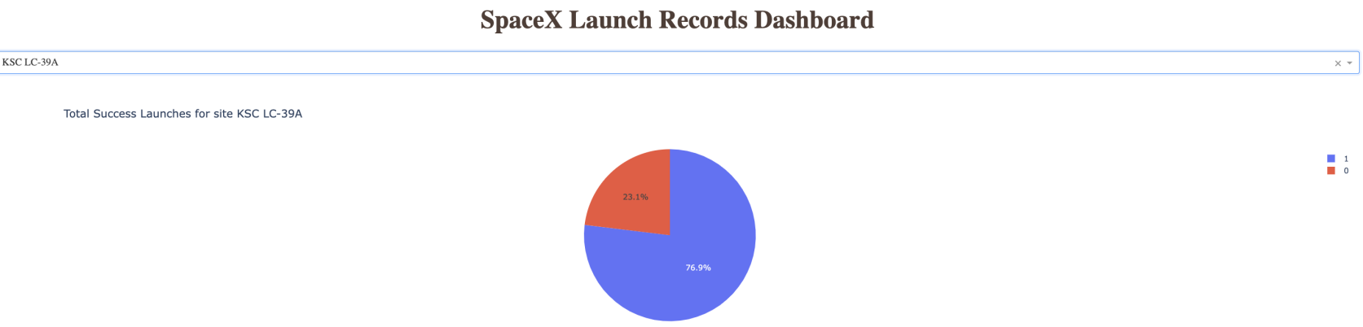
<Dashboard Screenshot 2>

Slide 40
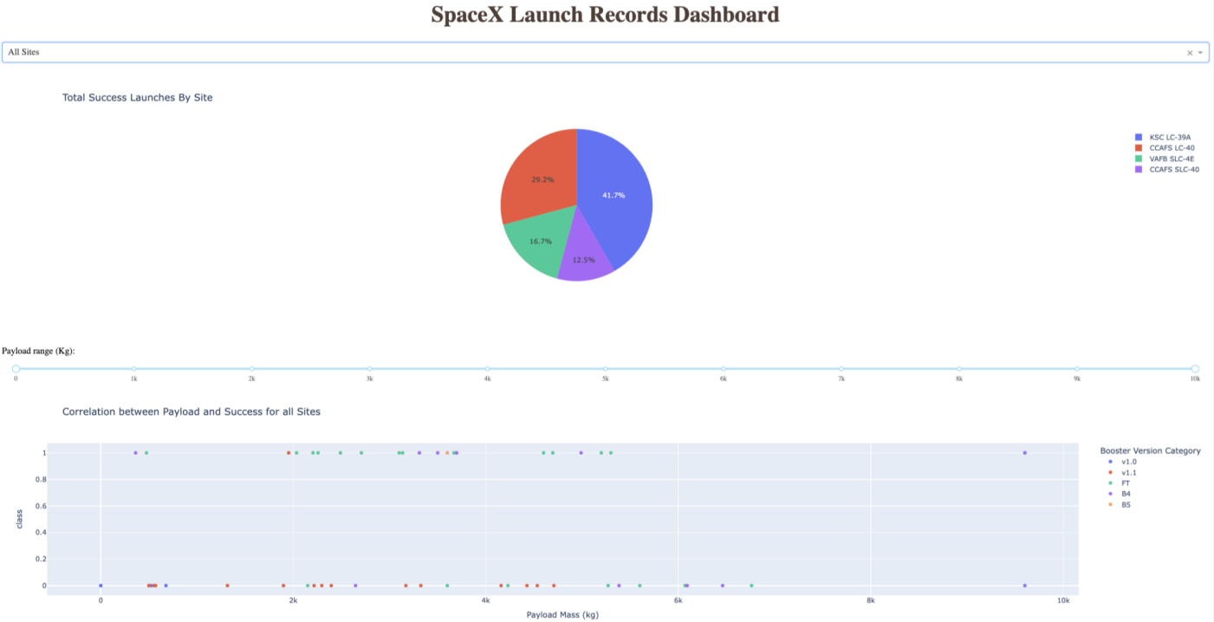
<Dashboard Screenshot 3>

Slide 41
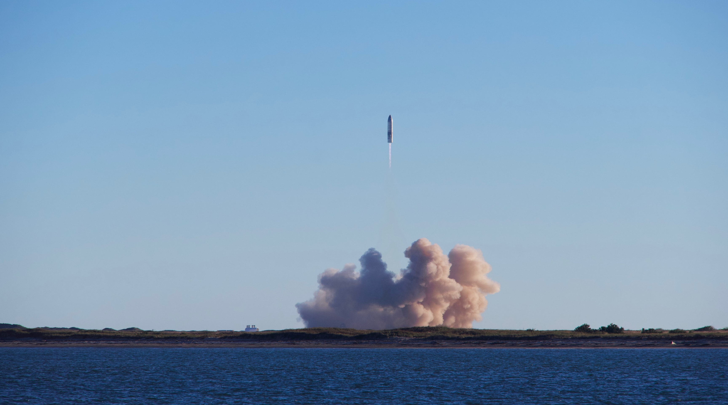
Predictive Analysis
(Classification)

Slide 42
Classification Accuracy
Decision tree is the best model in terms of prediction accuracy in this dataset.

Slide 43
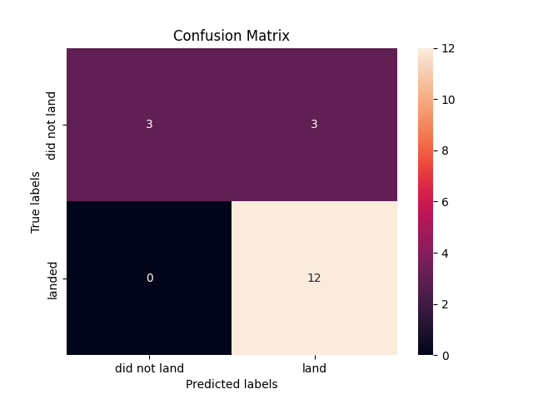
Confusion Matrix

Slide 44
Conclusions
Decision tree is the best model in terms of prediction accuracy in this dataset.
Low weighted payloads perform better than the heavier payloads.
4 classification method models used: Logistic Regression, SVM, Decision Tree, and KNN.

Slide 45
Appendix
In case you are interested in exploring the coding files used in this presentation, you can visit my GitHub page, where all of the files are available. I have added the individual links to the files throughout the presentation.
Thank you for taking the time to read my presentation. I hope you found it informative and enjoyable.

Slide 46

Thank You

